Slide 1
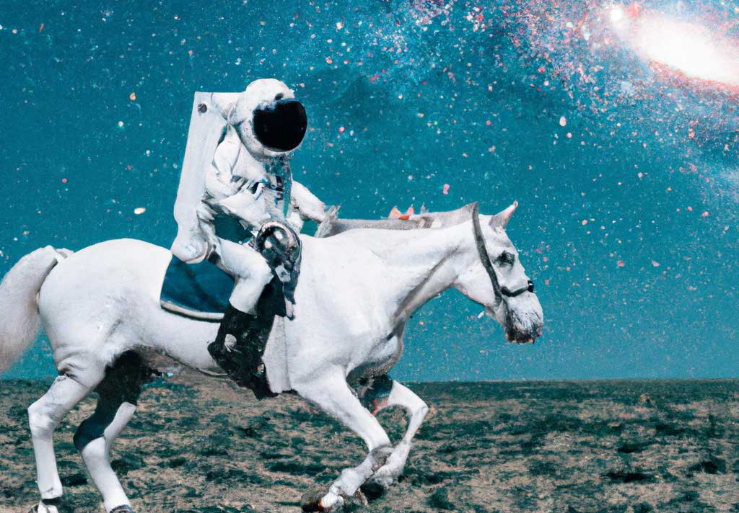
Text-to-Image Generation

Slide 2
Compute vision:
Image classification
Object detection
Segmentation
Image generation
CNN’s are widely used
Natural Language Programming:
Text classification
Text prediction/ generation
Translation
Transformers are widely used

Slide 3
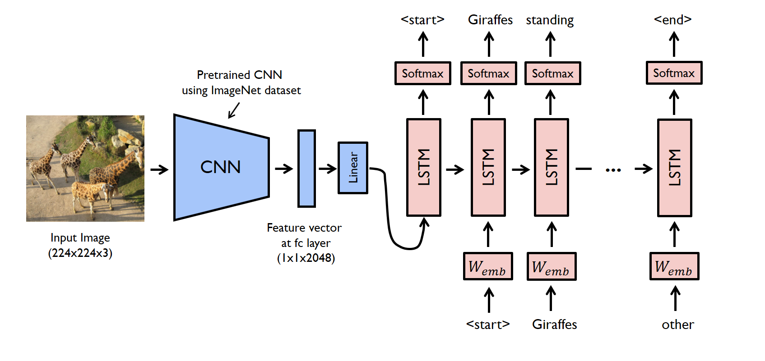
Idea - Mix CV + NLP

Slide 4
VQ-GAN + CLIP
VQGAN = Vector Quantized Generative Adversarial Network
Takes in a noise vector, and outputs a (realistic) image.
2) CLIP = Contrastive Language–Image Pre-training
Takes in:
- (a) an image, and outputs the image features; or - (b) a text, and outputs text features.

Slide 5
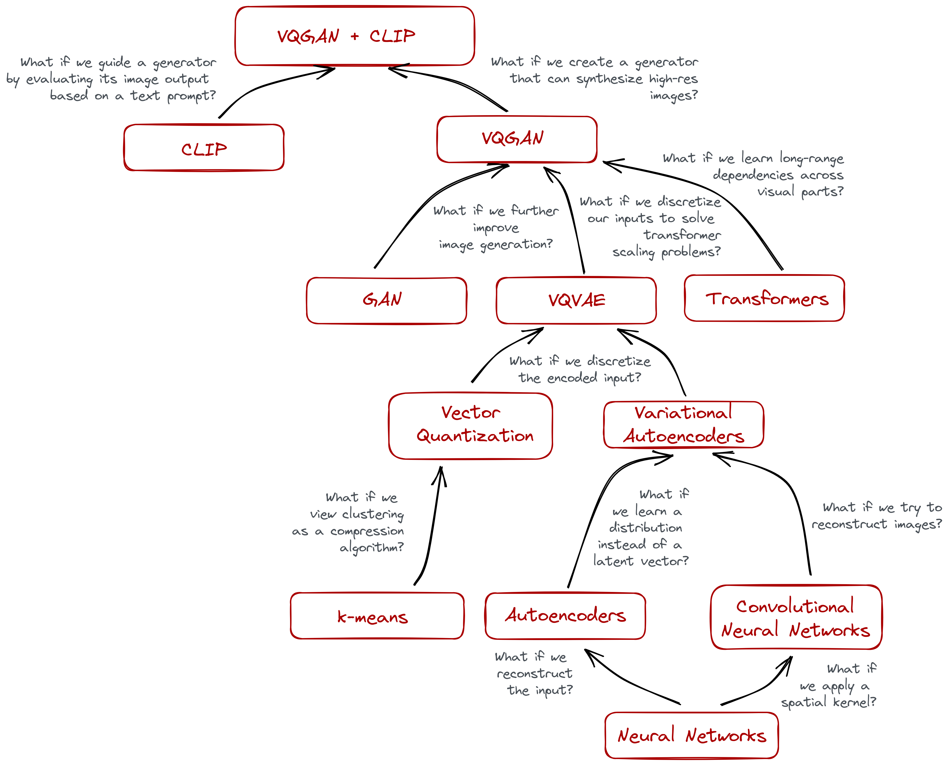
blog post

Slide 6
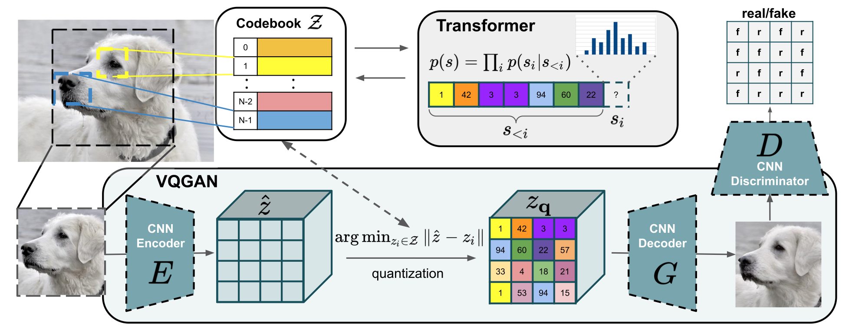
VQ-GAN

Slide 7
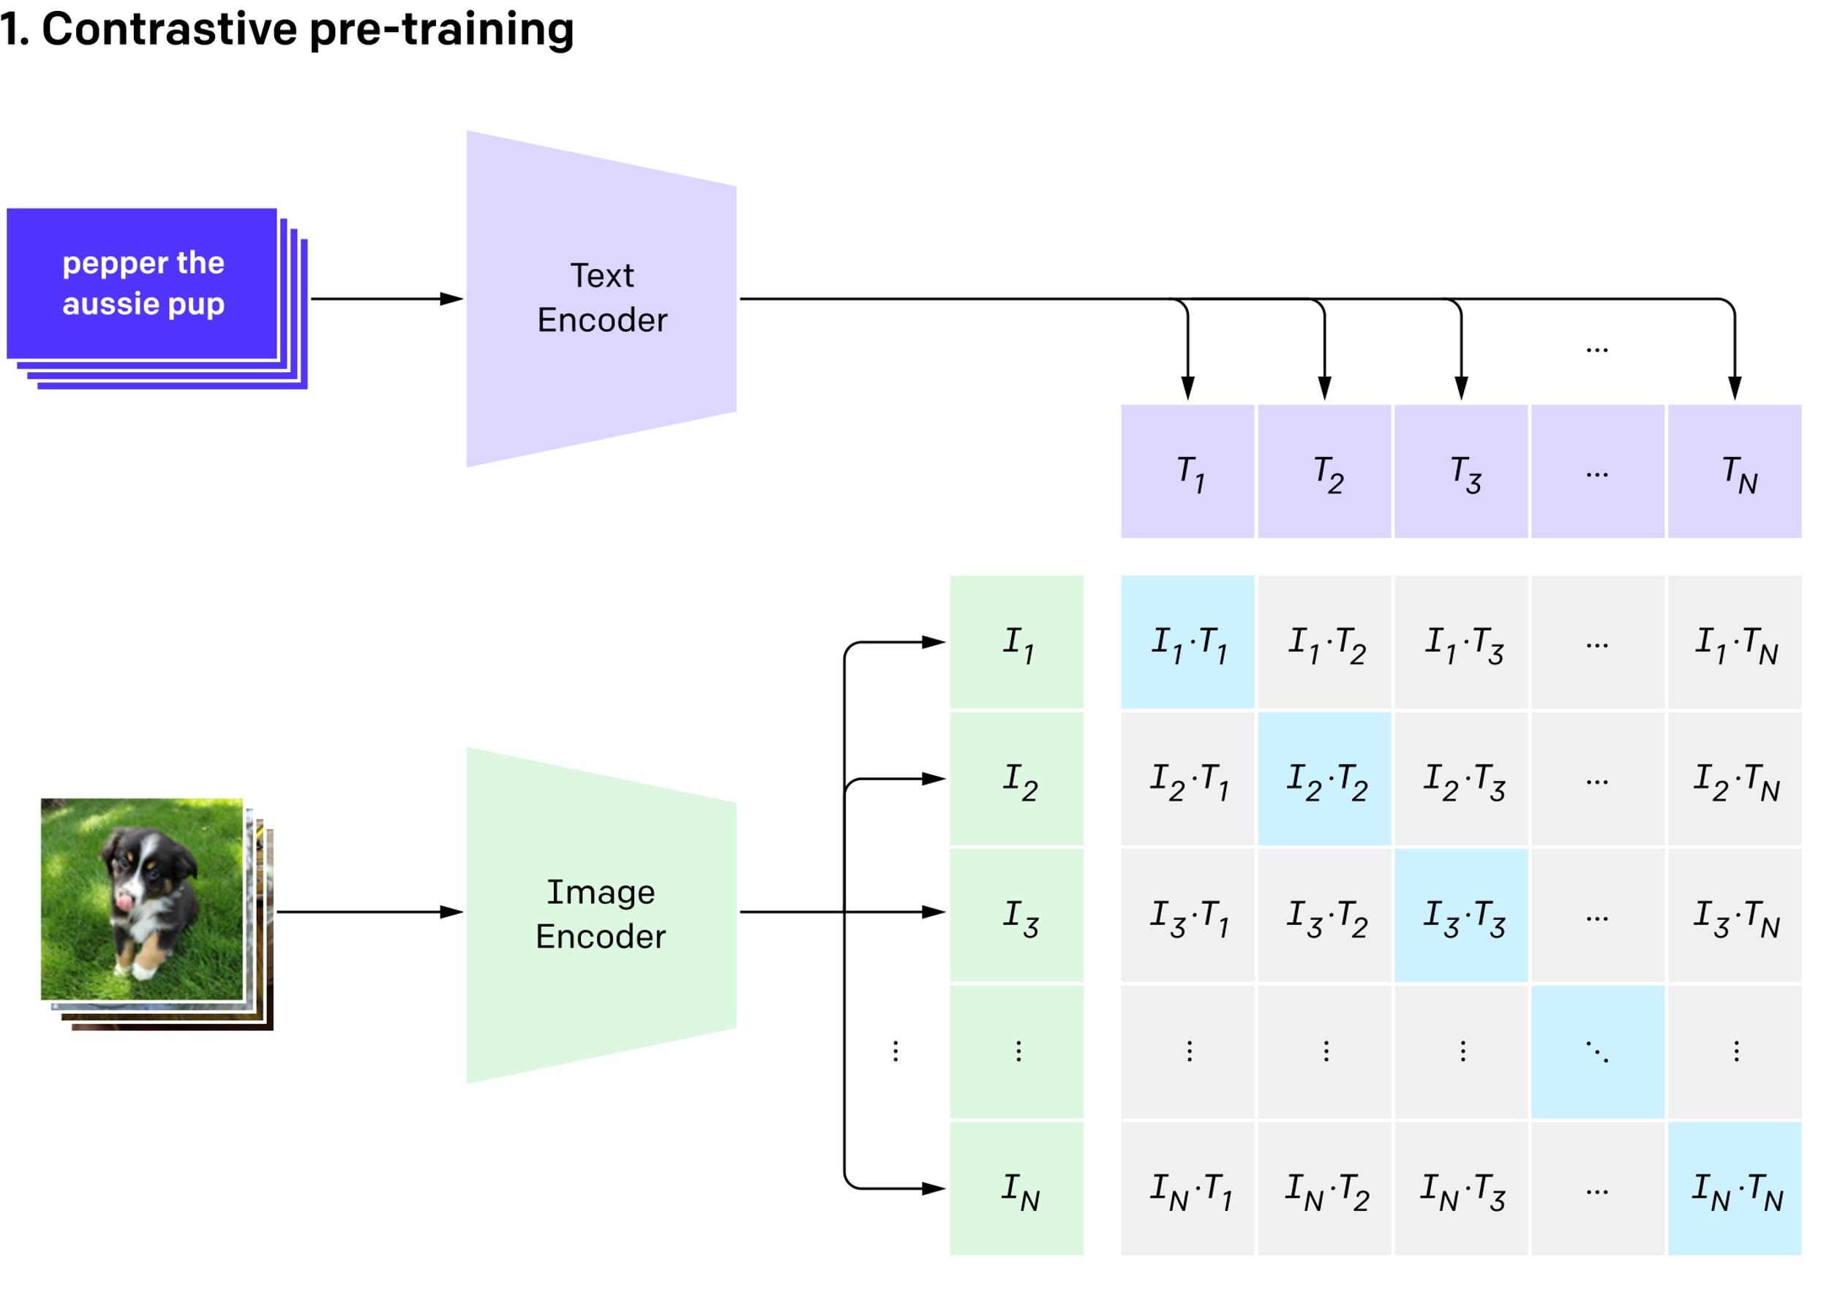
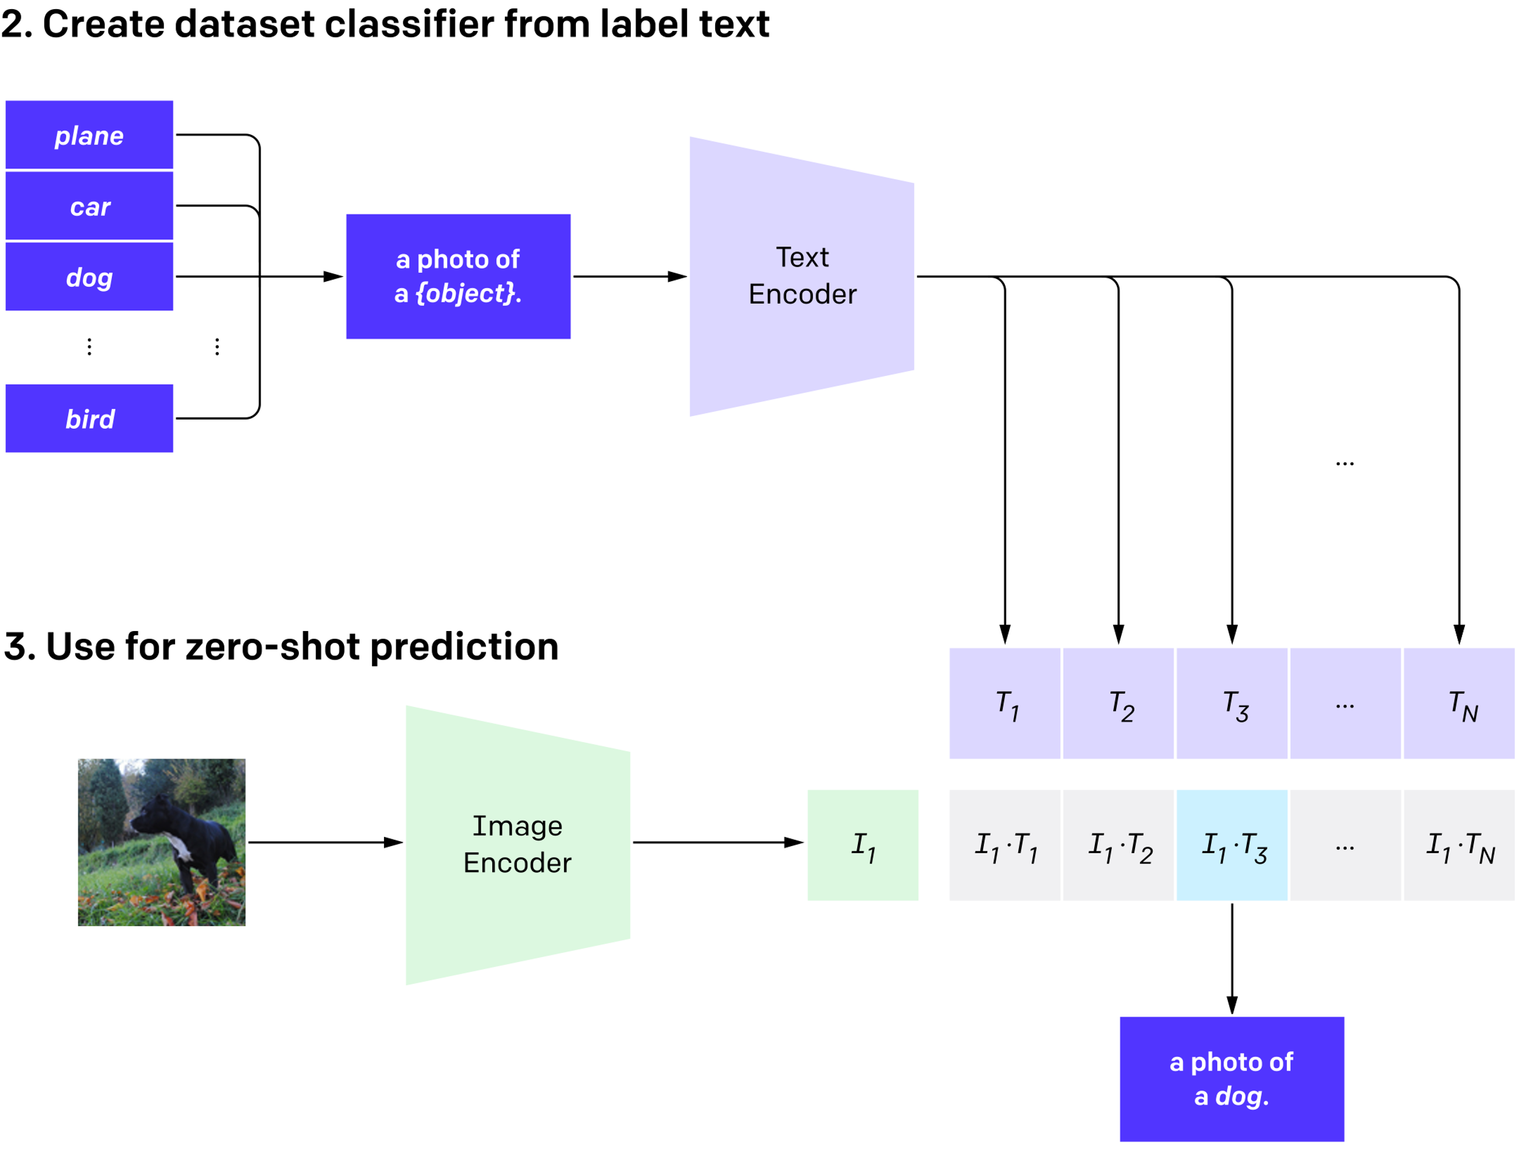
CLIP

Slide 8
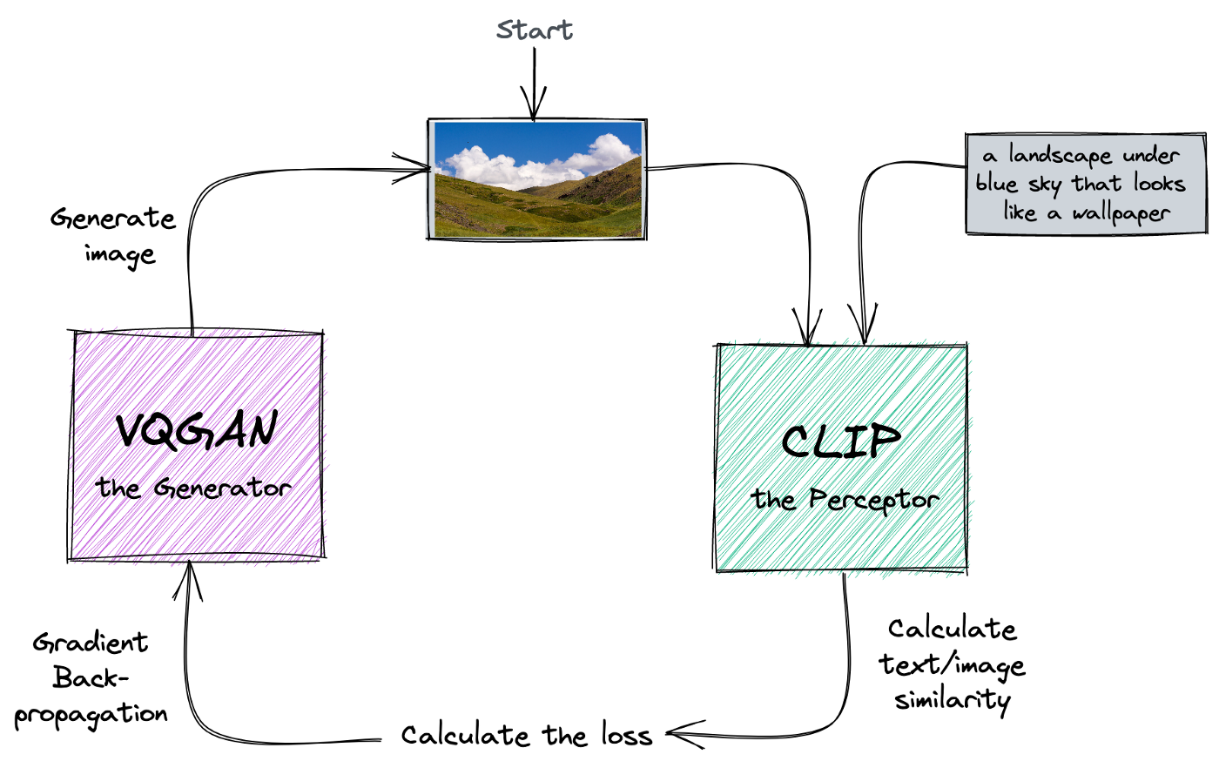
img source

Slide 9
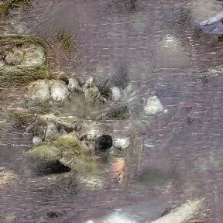
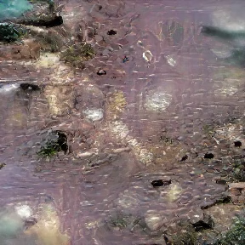
Hands-on: VQ-GAN + CLIP
yellow flower pigeons flying under water
Frida Kahlo hat cat flowers red clouds

Slide 10
DALL-E and DALL-E2

